Slide 1

Life in a Sunless Sea Trevor, John, Isla, Mihir, Divit, Philip
Beyond Sunlight: An Aquatic Chemosynthetic World

Slide 2
Background
The task is to envisage what a world that only had chemosynthetic life.
We decided that a board game would be a way for people to learn about chemosynthetic life AND generate many millions of possible worlds.
In our thinking we have a planet covered in a thick icesheet with liquid water beneath.

Slide 3


Science
We looked at how chemosynthetic life works on earth:
Thermal vents (Black smokers)
Cold Seeps (White smokers)
Chemistry – there are other combinations, but we stuck to theses ones
Conditions
Solvent
Chemicals
A key ingredient is consistent conditions

Slide 4
The board game
Initial thoughts were for a happy families type card game, or maybe each player would play their as individual planets trying to develop life before the others.
In the end we felt a game where all players played on the same planet.
Aimed at 10 years +
A planet made up of hexagons which could be shuffled and laid out randomly to create a new world. Some hexs would be vents or seeps.
Life would develop on the intersection of 3 hexs where the two key compounds and the correct conditions existed.
We did ask ChatGPT and GeminiAI, but neither suggested anything better (or anything we liked)
We built a prototype and played it - AND it worked
We then refined our design.

Slide 5
Current design
63 Hexs make up the planet. Mostly barren hexs
There are a possible 6 vents and 6 seeps in the initial layout with spare vents and barren in case of meteorite strike or volcanic action
Player take turns in taking 2 Element or action cards.
Make up chemical compounds with elements they have in hand
Trade elements with other players.
Place compounds
Place life cards
Do actions like meteorite strike, climate change or volcanic action which change the conditions on various hexs so life develops or is destroyed.
Once a player gains 10 points the game ends and the exoplanet has been created.

Slide 6
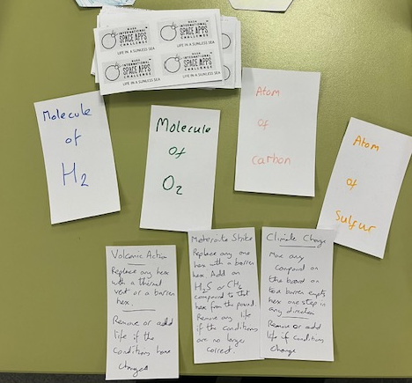
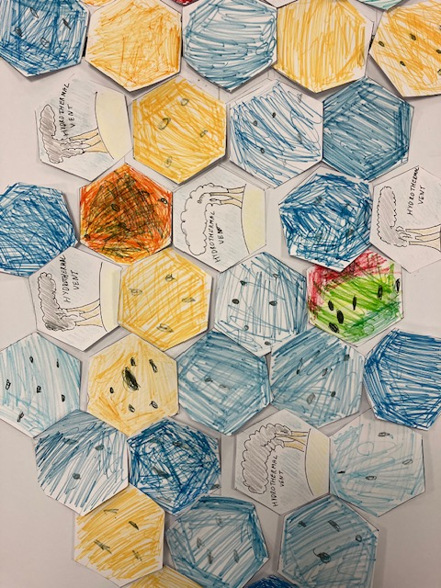
Playing elements
Element and Action Cards
Hex cards

Slide 7
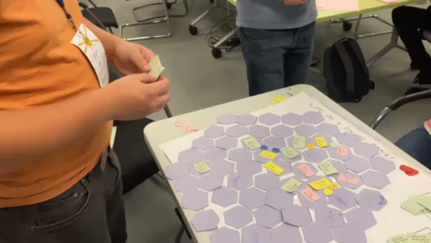
GAME PLAY

